Slide 1


Final Project: Dijkstra’s Algorithm
Paul-Ann Francis
Ahmed Ghoneim
Guillermo Medina
Ameena Mohammed

Slide 2


Table of Contents
Description of Algorithm
Graph Data Structure
Time and Space Complexity
Functionality

Slide 3

Description of Algorithm

Slide 4
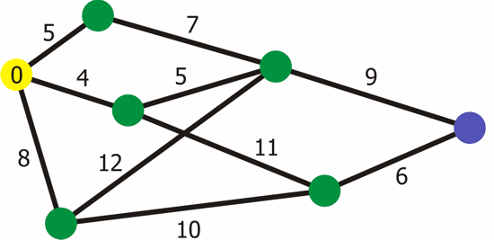
Description of Algorithm
Dijkstra's Algorithm is based on a pure greedy approach to find the minimal amount of steps to reach a destination.
Path property and Visited property are two main properties for each vertex
The shortest path to a vertex is found by comparing the weight or cost on each edge
Relaxation process is used to lower the cost of reaching a vertex by using another vertex
All the above points are continuously repeated until all the vertices in the graph are marked visited.

Slide 5

Graph Data Structure

Slide 6
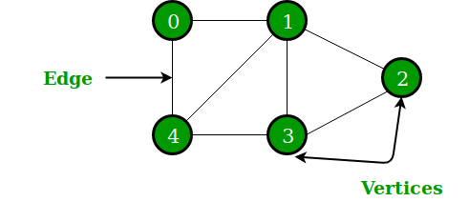
Graph Data Structure
Graphs consists of nodes called a vertex and their edges that connect these vertices to other vertices. The edge is given a weight which is simply a number that is used as the distance between two vertices.
The Vertex, Edge and Graph are all separated into classes where the first two are then used and implemented inside the latter Graph class.
The graph uses a Priority Queue to store weighted vertices by distance from the starting node from smallest to largest.
The graph represents non-linear data structure based more on the relationship between vertices

Slide 7

Time and Space Complexity

Slide 8
Time and Space Complexity
Adding a vertex and an edge is O(1).
For adjacency list representation, it takes O(E Log V) and can be further reduced into O((V+E )Log V) by using a Fibonacci Heap.
All the vertices can be traversed in O(V+E) time by using Breadth First Search which uses a Queue Data Structure.

Slide 9

Functionality

Slide 10
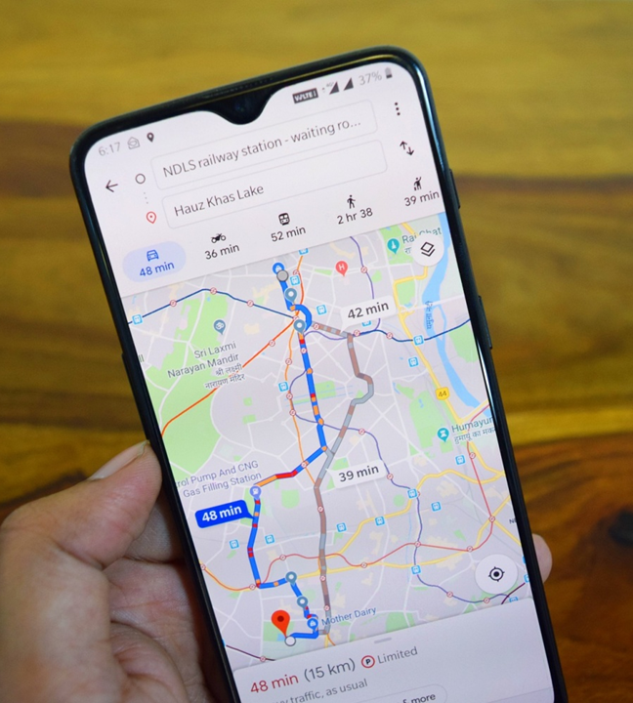

Functionality
Digital Mapping Services such as Google Maps - This Algorithm is used to find the minimum distance between two locations along with its path.
IP Routing - The algorithm can be used to find the shortest Open path in IP routing by using Open Shortest Path First which is a routing protocol that is used to find the optimal path between the source and destination router.
Social Media Applications - This algorithm can be utilized to find the shortest path between users measured by the number of connections and interactions made between users.

Slide 11
The End

